Slide 1
R Data Clinic
Robbie Richards & Kate Sabey
November 7, 2020
Notes:
Welcome to the IDEAS R Data Clinic! We hope you’re all ready for 2 days chock full of skills development and hopefully some fun!
10s

Slide 2
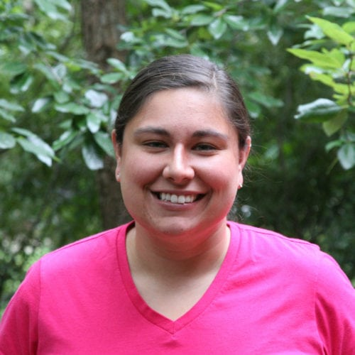
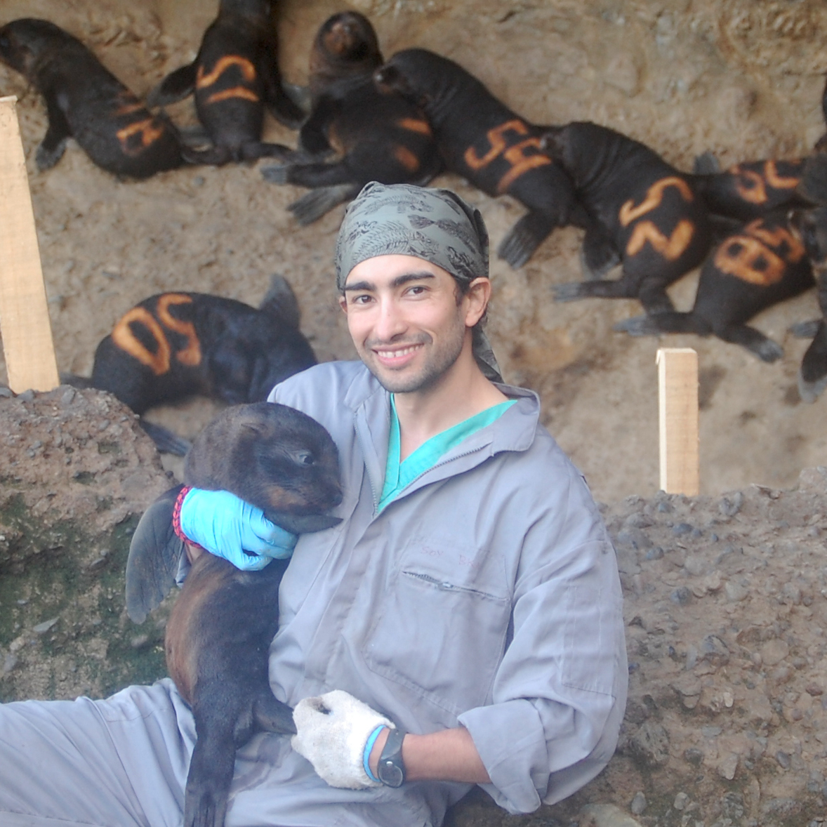

Brought to you by:
Dr. Ana Bento
Assistant Professor
Indiana University
Dr. Mauricio Seguel
Assistant Professor
University of Guelph
RajReni Kaul
PhD Candidate
University of Georgia
Notes:
Before we get started we wanted to take a moment to extend a thank you to the folks who have contributed to the development of this clinic over the past few years. Everything you’re going to work through has been developed, tested, and improved by these talented educators during their time at UGA.
30s

Slide 3
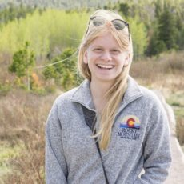

Brought to you by:
Kate Sabey
PhD Candidate
Infectious Diseases
Robbie Richards
PhD Candidate
Odum School of Ecology
Notes:
Introduce ourselves.
1min

Slide 4
Introduce yourselves!
Name
Pronouns
Degree Program/Department
Why are you excited to be here?!
Notes:
2 min breakout
10 min introductions
11:40 to this point

Slide 5
What is R?
Notes:
So this clinic does not assume any initial familiarity with R. We’re going to start with the basics here in this first hour and build up together.
25s

Slide 6
R is a language and environment for statistical computing and graphics
Notes:
So R is the name of a language and environment for statistical computing and graphics production.
<number>

Slide 7
R is a language and environment for statistical computing and graphics
The official R home page: http://www.R-project.org
Notes:
While the official R homepage is housed here
When I mention CRAN I will say this: is a network of ftp and web servers that store identical, up-to-date, versions of code and documentation and packages for R.
<number>

Slide 8
R is a language and environment for statistical computing and graphics
The official R home page: http://www.R-project.org
You download it from CRAN: https://cran.r-project.org/
Notes:
You actually downloaded R from a place called CRAN. CRAN is a network of web servers that store identical, up-to-date, versions of code and documentation and packages for R.
<number>

Slide 9
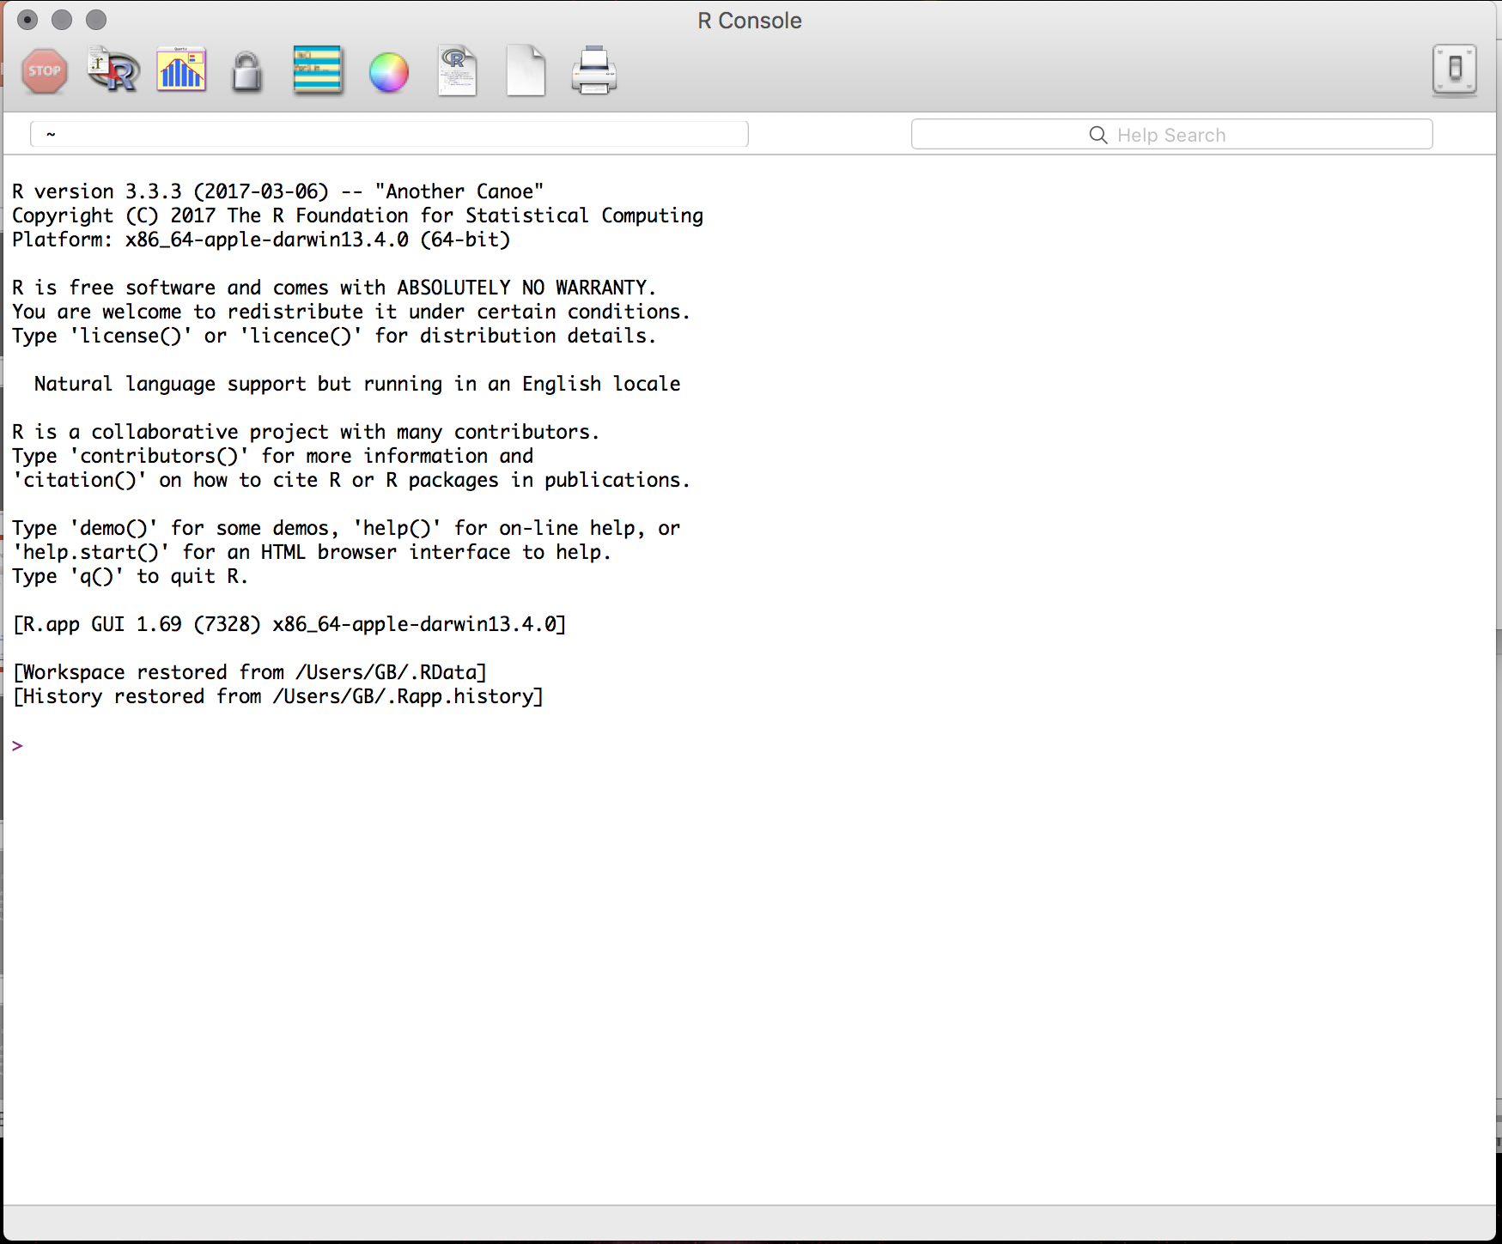
R is a language and environment for statistical computing and graphics
The official R home page: http://www.R-project.org
You download it from CRAN: https://cran.r-project.org/
The R system can be installed on, Windows, Mac or Linux
Notes:
R is really great for a lot of reasons. The first is that it can be easily installed and run on all common operating systems.
12:40 to this point
<number>

Slide 10
Why R?
Notes:
But there are lots of other statistical analysis software out there.

Slide 11
It’s free
Notes:
It's free!
<number>

Slide 12
It’s free
Popularity
Notes:
It’s extremely popular and widely used in Ecology, public health, and other sciences
<number>

Slide 13
It’s free
Popularity
Awesome power: can handle complex and large data
can easily program complex simulations
can be used on High Performance Computer Clusters
supports multicore task distribution
Notes:
It’s really powerful!
It can handle large and complex datasets
It can easily program complicated simulations
can easily program complex simulations
can be used on High Performance Computer Clusters
supports multicore task distribution which can speed up repetitive tasks A LOT
<number>

Slide 14
It’s free
Popularity
Awesome power: can handle complex and large data
can easily program complex simulations
can be used on High Performance Computer Clusters
supports multicore task distribution
Flexibility
Notes:
It’s really flexible!
There are often many different ways to do a thing in R and you can adapt your code to so many different data types and situations
<number>

Slide 15
It’s free
Popularity
Awesome power: can handle complex and large data
can easily program complex simulations
can be used on High Performance Computer Clusters
supports multicore task distribution
Flexibility
Great support: Packages; vignettes; tutorials; free books; google
StackOverflow; Rbloggers my two personal favorites!
Notes:
There is also really great support for all of this flexibility and power in R!
Because R development is open-source scientists and programmers have developed so many different packages (or pieces of software) that give you the ability to do more and more things in R!
Along with these packages come vignettes and tutorials which walk you through how to use the package and there are also many free books available to read
Google is a fantastic tool as well! And will often take you to answers on websites like StackOverflow and Rbloggers
14:40 to this point
<number>

Slide 16
R Studio
Notes:
But we had you download something else too!
What is Rstudio?

Slide 17
Using R is easier with RStudio
Notes:
R studio is a user interface for the R programming language that makes using R even easier!
<number>

Slide 18
Using R is easier with RStudio
Cross platform application
Notes:
Like R it is available across all major operating systems
<number>

Slide 19
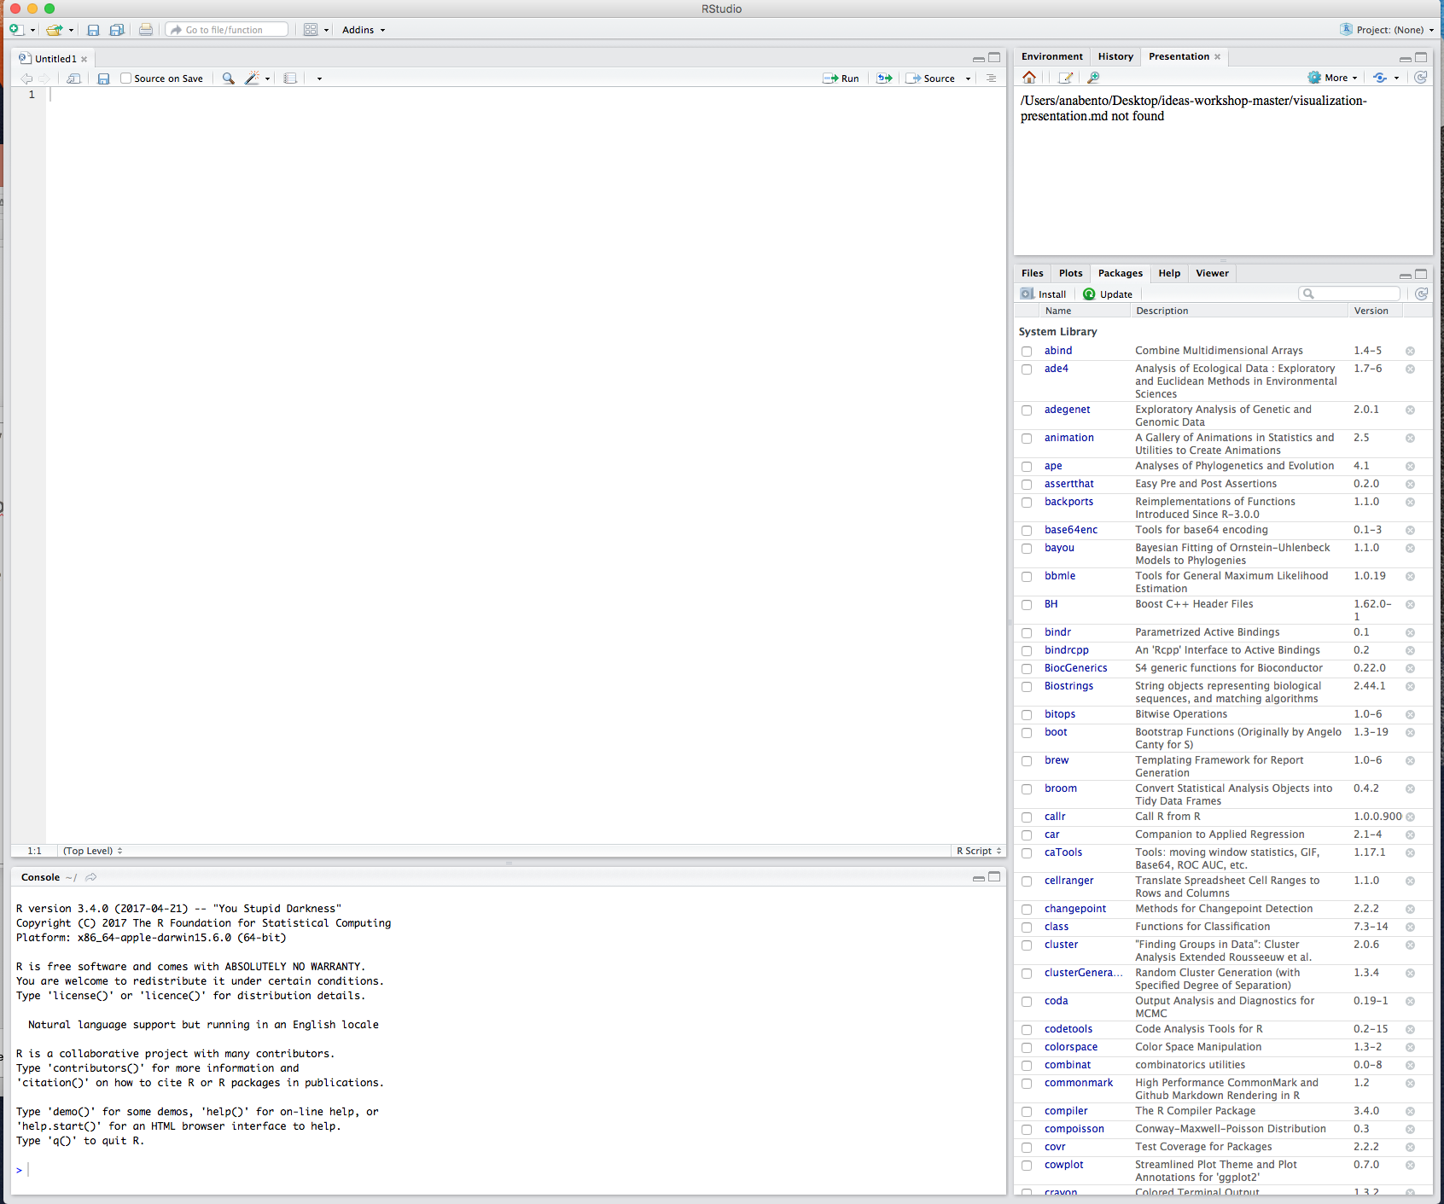
Using R is easier with RStudio
Cross platform application
Download it here: https://www.rstudio.com/products/rstudio/download
Lets open RStudio!
Notes:
Hopefully you’ve all already downloaded Rstudio but if not please do so now!
We’re going to open Rstudio and walk through what it looks like, how it works, and how we’re going to be using it.
<number>

Slide 20
When we first start we have 3 panes: The console (the brain)
The environment & history
Files, plots packages help
The environment and history
Files, plots packages help
The console
Notes:
Here have them type some basic operations and make a variable assignment!
8 min
<number>

Slide 21
Creating a new project

Slide 22
File →Project →New directory (a folder that RStudio will create)

Slide 23
File →Project →New directory (a folder that RStudio will create)
Empty Project → Name the directory and place it where you want (subdirectory of)

Slide 24
File →Project →New directory (a folder that RStudio will create)
Empty Project → Name the directory and place it where you want (subdirectory of)
The folder you created will be used to store all data related to your project

Slide 25
File →Project →New directory (a folder that RStudio will create)
Empty Project → Name the directory and place it where you want (subdirectory of)
The folder you created will be used to store all data related to your project
Including R workspace files, RStudio script files, data files (e.g., csv files), and custom functions

Slide 26
File →Project →New directory (a folder that RStudio will create)
Empty Project → Name the directory and place it where you want (subdirectory of)
The folder you created will be used to store all data related to your project
Including R workspace files, RStudio script files, data files (e.g., csv files), and custom functions
Each independent project that you undertake in R should be organized in a separate folder that contains everything you need for it
Notes:
24:40 to this point

Slide 27
R packages
Notes:
So I mentioned a bit earlier the concept of R packages which are like self-contained packets of functions that allow you to do different things in R

Slide 28
R’s functionality is distributed among many packages
Notes:
The enormous functionality that R has is distributed across many packages
<number>

Slide 29
R’s functionality is distributed among many packages
e.g. stats package contains functions for statistical methods
Notes:
For example the stats package contains functions for basic statistical methods
<number>

Slide 30
R’s functionality is distributed among many packages
e.g. stats package contains functions for statistical methods
When you download R you get a set of base packages
Notes:
When you download R you get a set of base packages. These are often referred to as “Base R”
<number>

Slide 31
R’s functionality is distributed among many packages
e.g. stats package contains functions for statistical methods
When you download R you get a set of base packages
You can download and install add-on packages
Notes:
But there are literally thousands of additional packages that you can download and add on
<number>

Slide 32
R’s functionality is distributed among many packages
e.g. stats package contains functions for statistical methods
When you download R you get a set of base packages
You can download and install add-on packages in a variety of ways
Using the command line install.packages(“ggplot2”)
Notes:
While there are a couple of different ways to install packages we’re just going to focus on the most basic way which is using the function install.packages()
If you type what you see there on the screen into your command line it will install the package ggplot2 which is a graphing package. Note that the name of the package that you are installing must be in quotation marks.
26:00 to this point
<number>

Slide 33
R Documentation
Notes:
But if there are all these packages. How do we know how to use them? That’s where documentation comes in.

Slide 34
https://cran.r-project.org/web/packages/ggplot2/index.html
Notes:
Documentation that explains how to use a package can be found in many places.
The most common place to find it is on the cran website. You can copy this url or just search for ggplot2 cran to get to the page
<number>

Slide 35
https://cran.r-project.org/web/packages/ggplot2/index.html
Reference manual pdf
Notes:
On this page you will find the reference manual pdf. These are always formatted in the same way with a description of the package at the top followed by an alphabetical listing of all the functions in the package, how to use them, and what they do.
<number>

Slide 36
https://cran.r-project.org/web/packages/ggplot2/index.html
Reference manual pdf
Vignettes
Notes:
Many packages (like ggplot2) also contain vignettes which are usually tutorials or how-to guides written by the package authors to help you use the package
<number>

Slide 37
https://cran.r-project.org/web/packages/ggplot2/index.html
Reference manual pdf
Vignettes
https://www.rdocumentation.org/packages/ggplot2/versions/2.2.1
Notes:
Many packages also have documentation on rdocumentation.org
<number>

Slide 38
https://cran.r-project.org/web/packages/ggplot2/index.html
Reference manual pdf
Vignettes
https://www.rdocumentation.org/packages/ggplot2/versions/2.2.1
Using the console to search for info on a specific function
e.g. ?read.csv or ??read.csv
Notes:
But the quickest way to get at the help and documentation for a specific function within a package is to type the function name into the console preceeded by a question mark. This will make the information on that function from the manual pdf pop up into your rstudio window. Very handy!
30 min to this point
<number>

Slide 39
Reproducibility
Notes:
One of the really great strengths of R and Rstudio that we won’t be stressing too much in this clinic is the reproducibility of your analyses and research.

Slide 40
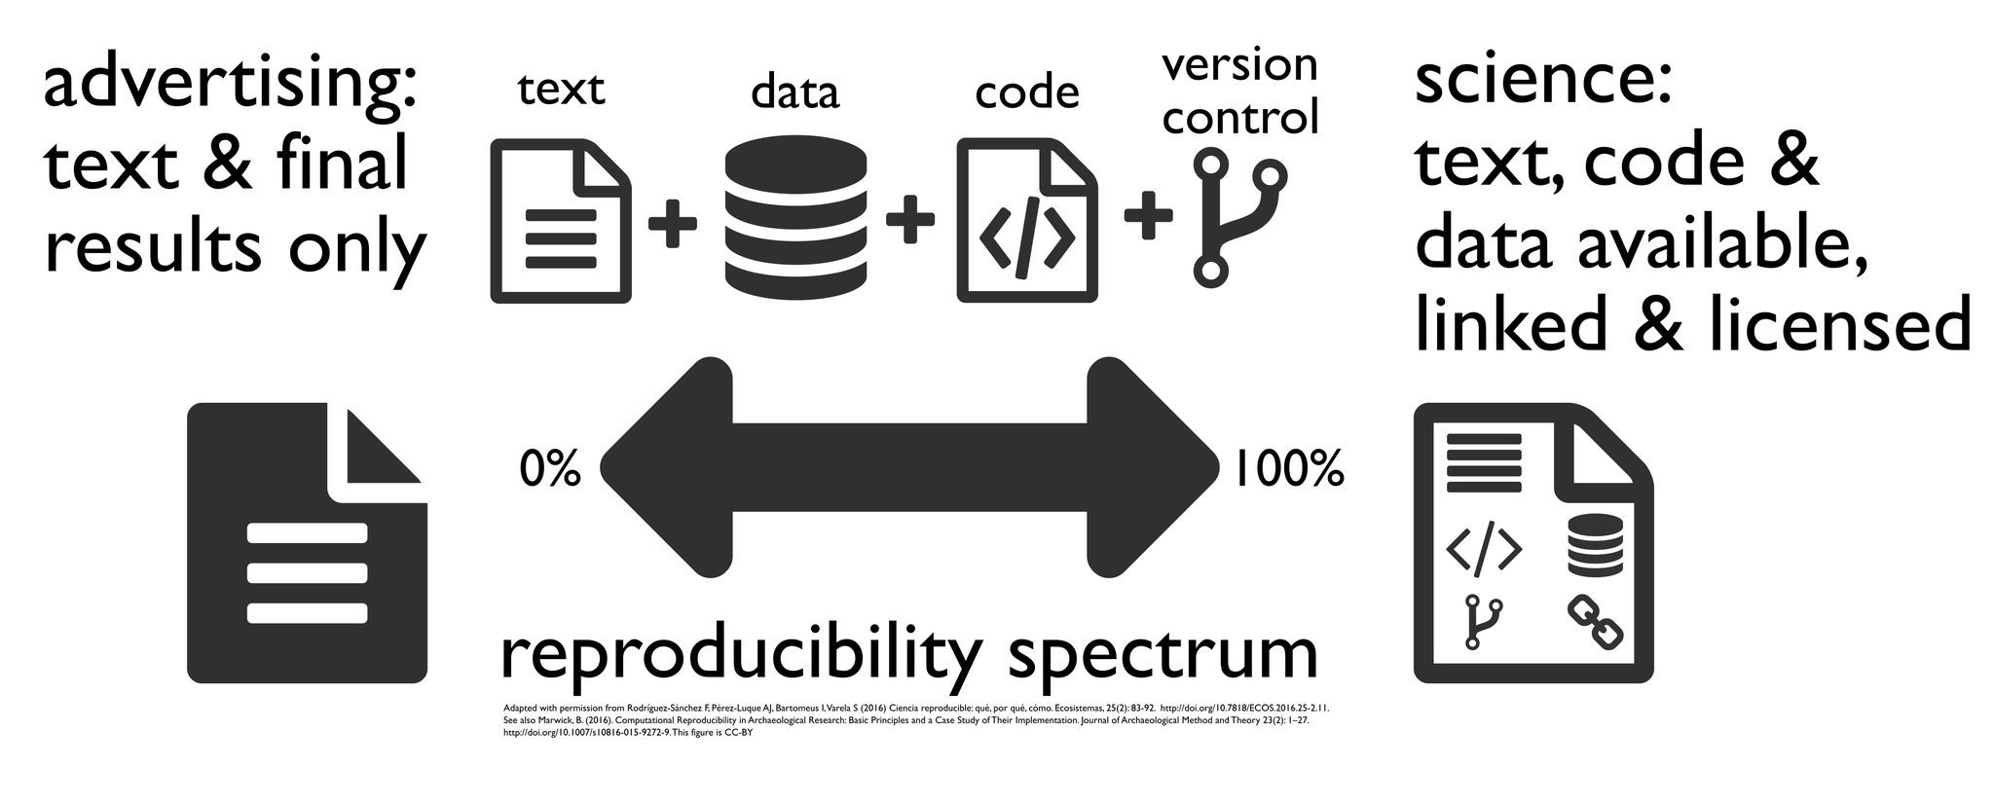
Notes:
There is a spectrum of how well another person could reproduce your analyses from a publication. If you only provide them with the text of the methods then they may find it nearly impossible to check your work. Providing the data makes it easier but you run the risk of them misinterpreting your written methods. But if you also provide the code you use to conduct the analysis then they can run that code themselves and see how you got your result (and directly check for any errors in the code). This is true for your readers and collaborators but it is also true for your most common collaborator, your future self.
32 min
<number>

Slide 41
Goals
Notes:
Ok so now we’ll go over some high-level goals for this clinic.

Slide 42
In this clinic you will develop a variety of useful skills for data manipulation and analysis in R:
Notes:
The purpose of this clinic is not to deliver content into your brain but rather for you to develop and practice skills. This will require some content delivery but our hope is that after this clinic you will be better able to manipulate and analyze data in R.
<number>

Slide 43
In this clinic you will develop a variety of useful skills for data manipulation and analysis in R:
Write functions
Notes:
This includes writing functions
<number>

Slide 44
In this clinic you will develop a variety of useful skills for data manipulation and analysis in R:
Write functions
Clean and manage data
Notes:
Cleaning and managing data
<number>

Slide 45
In this clinic you will develop a variety of useful skills for data manipulation and analysis in R:
Write functions
Clean and manage data
Calculate summary statistics
Notes:
Calculating summary statistics
<number>

Slide 46
In this clinic you will develop a variety of useful skills for data manipulation and analysis in R:
Write functions
Clean and manage data
Calculate summary statistics
Conduct statistical analyses
Notes:
Conducting statistical analyses
<number>

Slide 47
In this clinic you will develop a variety of useful skills for data manipulation and analysis in R:
Write functions
Clean and manage data
Calculate summary statistics
Conduct statistical analyses
Plot results
Notes:
And plotting or visualizing your results
34 min
<number>

Slide 48
Today
Notes:
Our work today is divided up into a number of sessions with solid break periods in between.

Slide 49
Data Manipulation and exploration – Code Along
Navigating Data Types
Vectors
Matrices
Factors
Data frames
Lists
Writing and using Functions
syntax and examples of functions
control and logic statements
loops
summary stats
Data Manipulation and exploration – Review and Advanced Skills
Notes:
We are going to start out with a Code Along activity where Kate is going to guide you through using R to explore a cool dataset about the sinking of the titanic. This section is meant to show off some of the cool skills that you’ll develop further over the next two days while also giving you a chance to get hands on with data before we pivot temporarily to some slightly dryer material.
<number>

Slide 50
Data Manipulation and exploration – Code Along
Navigating Data Types
Vectors
Matrices
Factors
Data frames
Lists
Writing and using Functions
syntax and examples of functions
control and logic statements
loops
summary stats
Data Manipulation and exploration – Review and Advanced Skills
Notes:
Next we’re going to introduce you more methodically to the different ways that R handles data and the different types of data you can work with.
<number>

Slide 51
Data Manipulation and exploration – Code Along
Navigating Data Types
Vectors
Matrices
Factors
Data frames
Lists
Writing and using Functions
syntax and examples of functions
control and logic statements
loops
summary stats
Data Manipulation and exploration – Review and Advanced Skills
Notes:
Then you’re going to try your hand at writing some basic functions as well as using common functions for calculating summary statistics.
We’ll also cover some very common but unconventional functions like if-then statements and for loops that can add a lot of flexibility and power to your code
<number>

Slide 52
Data Manipulation and exploration – Code Along
Navigating Data Types
Vectors
Matrices
Factors
Data frames
Lists
Writing and using Functions
syntax and examples of functions
control and logic statements
loops
summary stats
Data Manipulation and exploration – Review and Advanced Skills
Notes:
Finally we’ll come full circle with another session on data manipulation and exploration. We’ll review what we did at the beginning of the day and introduce some advanced skills while also giving you more freedom to explore!
All of these sessions will involve a combination of quasi-lecture, individual exercises, and collaborative exercises!
<number>

Slide 53
Tomorrow

Slide 54
Data visualization
basic
ggplot
plottly (interactive plots)
Data Wrangling
Statistical Analysis
Notes:
Tomorrow we’re going to start out the day with developing data visualization skills
While after lunch we’re going to take a real and really messy infectious disease dataset. Clean it up together and then conduct some statistical analyses on it.
40 min
<number>

